Slide 1
BUSCA
Aldo Rogliero
Nyle Malik
John Lee
JingXuan Wang
Salomon Nabine

Slide 2
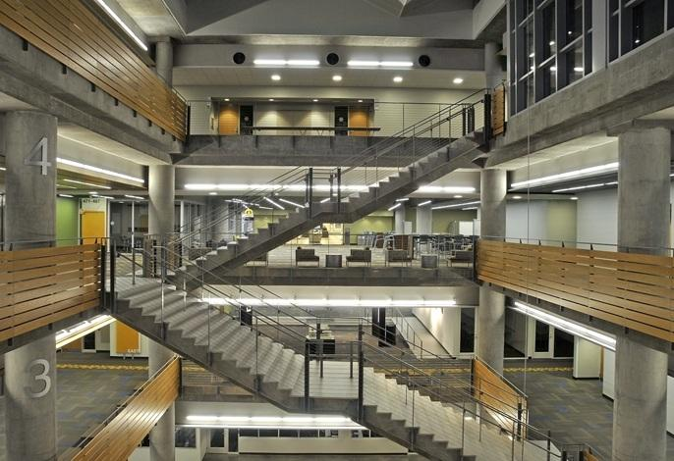
Motivation
The CULC problem
Nice study spaces
Huge building
Always packed

Slide 3
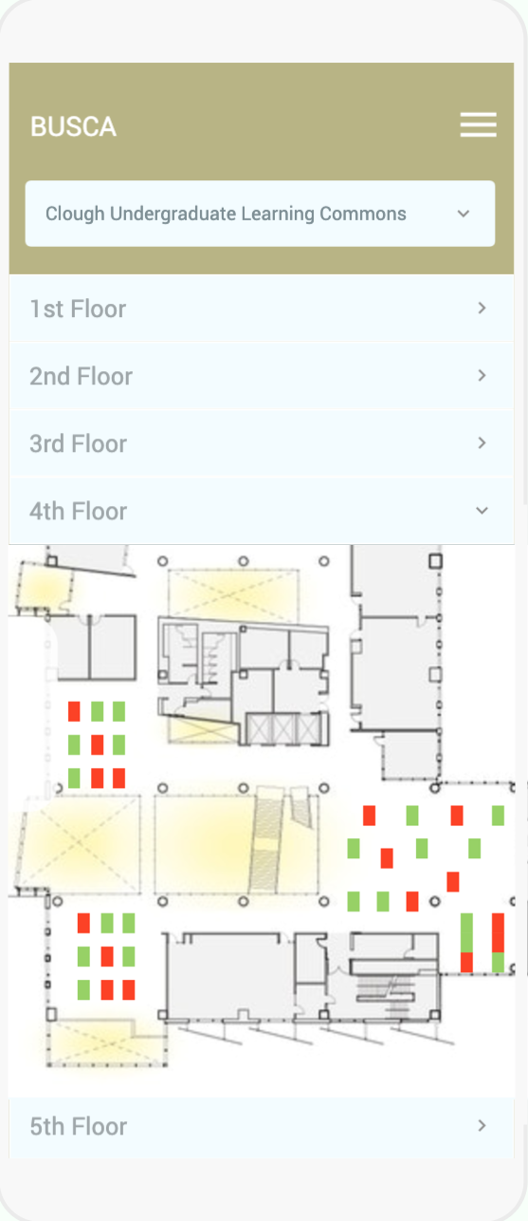
Objective
Connect students with available study spaces in real time
Cost-effective, non-invasive
User friendly UI

Slide 4
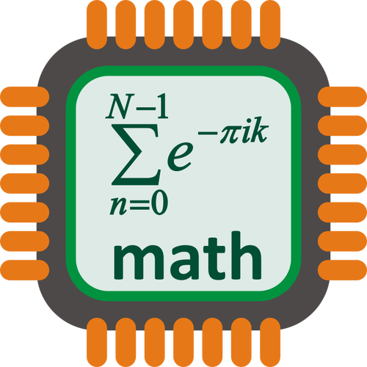
Background
Cloud Server
Microcontroller Unit Network
Proximity Sensor

Slide 5
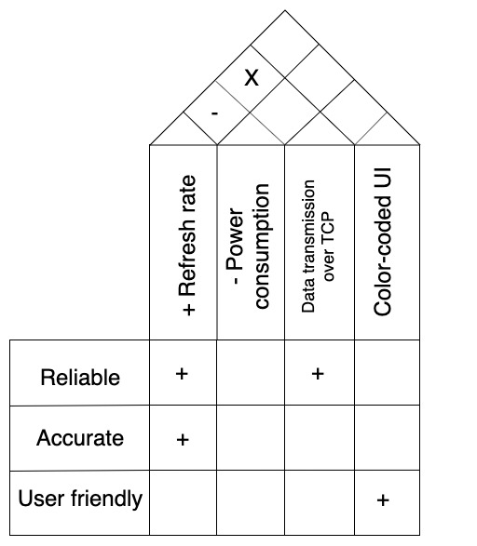
Project Description and Goals
Prototype
Battery-powered module containing MCU, proximity sensors, and Wi-Fi capability
Non-invasive and discrete
Determine presence of people at study space 90% of the time
iOS Application
Color-coded map of available study spaces
Refresh rate of 10 minutes
Network
AWS for cloud server (IoT)
MQTT over TCP for communication between devices, server, and mobile app

Slide 6
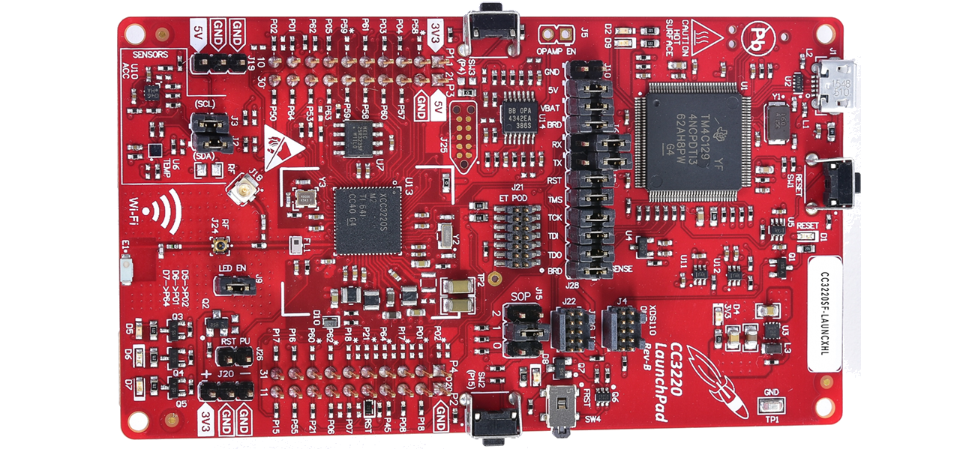
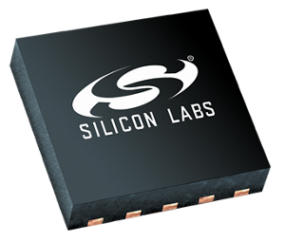
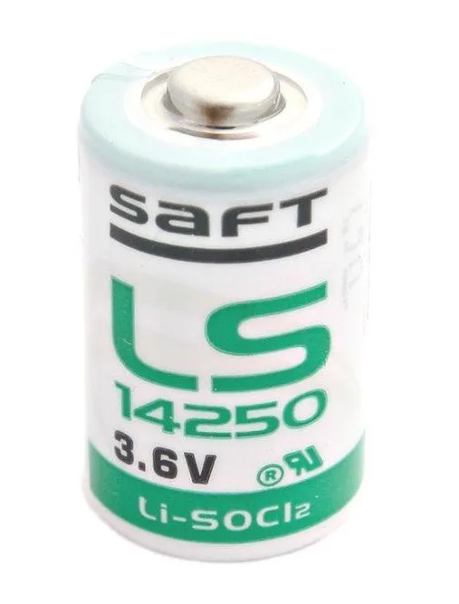
Technical Specifications
MCU | Proximity Sensor | Power
I2C Interface Wi-Fi Connectivity 15mm x 15mm x 2mm Current Draw: < 200 μA | Voltage: 3.3 V Current Draw: < 100 μA Minimum Range: 50 cm Minimum Angle: 40° 90% confidence | Life: 4 months Capacity: > 1 Ah Easily replaceable

Slide 7
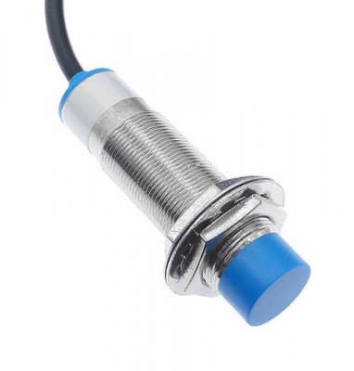
Design Approach——Sensors and Microcontroller
Multiple sensor connecting to MCU via I2C
Local data collection and processing
Microcontroller uses Wi-Fi to connect to server

Slide 8
Design Approach——Server and Mobile App
Uses Message Queuing Telemetry Transport (MQTT), runs on TCP
Periodically retrieves data from MCU and updates on App

Slide 9
Design Approach——Major constraints
Sensor range, accuracy and cost
MCU power consumption and maintenance

Slide 10
Scheduling
Project Planning (35 days)
Location Inspection
Part Ordering
Documentation
Device Implementation (62 days)
Hardware Implementation
Software Implementation
Mobile App (83 days)
Back-end Architecture
UI Design and Experience

Slide 11
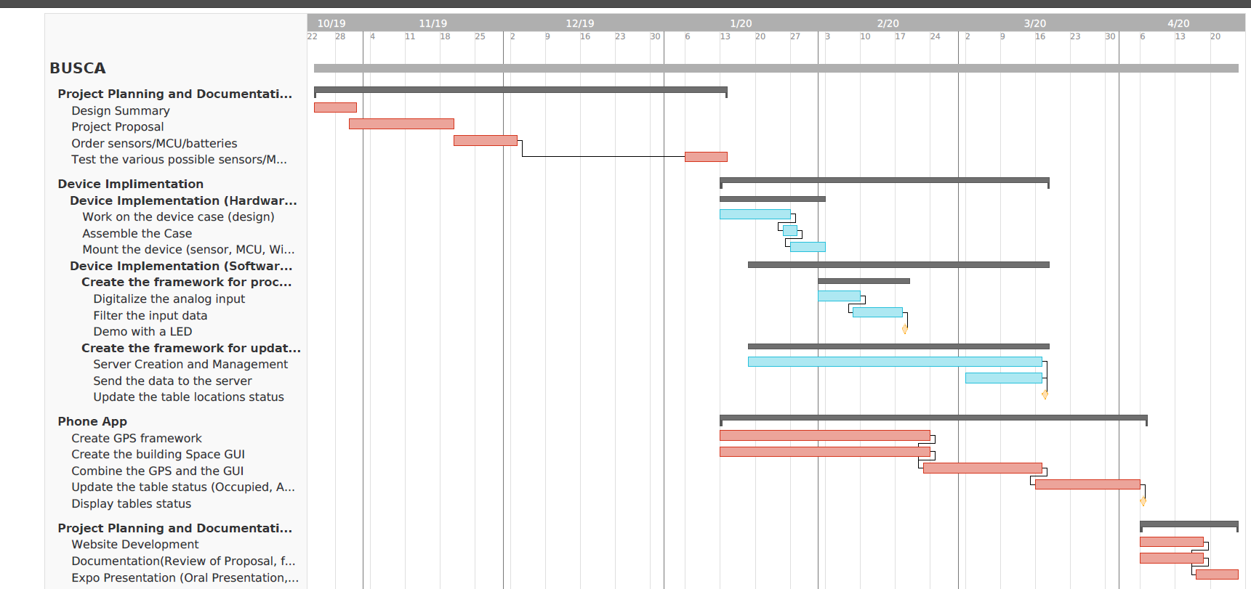
Gantt Chart

Slide 12
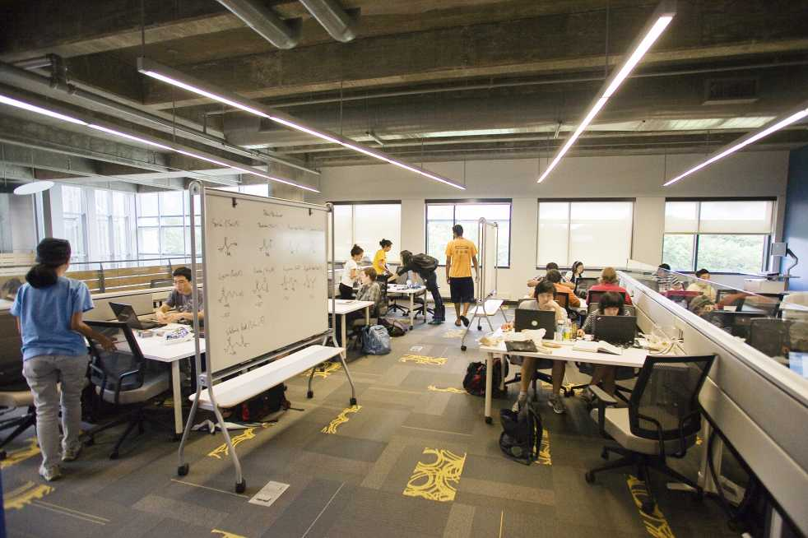
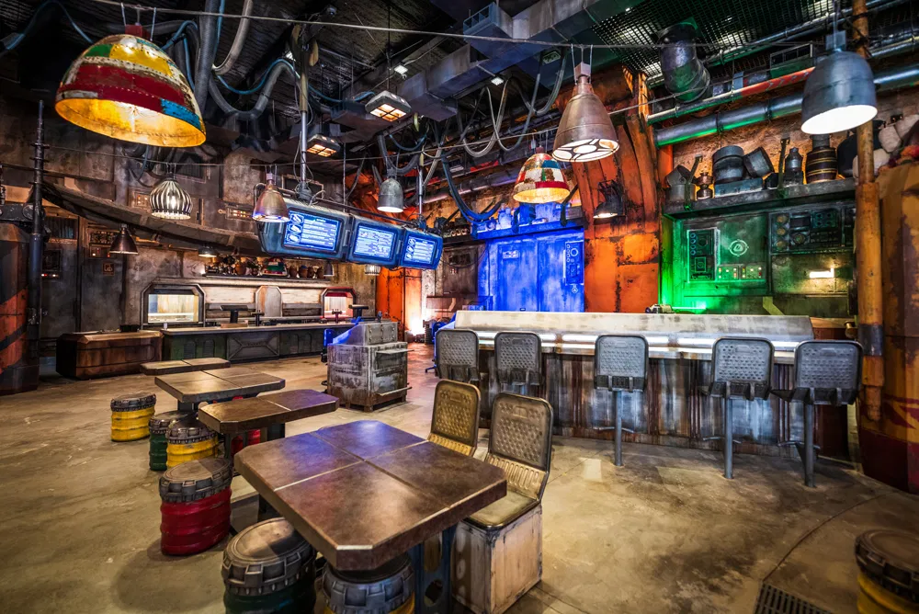
Market and Cost Analysis
Target market is college and university campuses
Potential for counter-serve restaurants
No direct competitors
Prototype Costs | $79.58
Labor Costs | $46,827.00
Total Development Costs | $133,925.22

Slide 13
Business Model
10,000 unit production round
10 clients expected within five years
Clients must sign a one year minimum contract
Setup Fee (per unit) | $35
Operation Fee (per month per unit) | $12
Revenue (one year of operation per unit) | $179.00
Profit (one year of operation per unit) | $34.77, 19.42%
Total Revenue | $1,790,000.00
Total Profit | $370,770

